Slide 1
Ocular Disease Recognition with Deep Learning
Hasmik Tumanyan
My GitHub Link https://github.com/HasTum

Slide 2
Problem Statement
According to the World Health Organization (WHO), there are around 2.2 billion people who are visually impaired worldwide, and at least 1 billion of these cases might have been prevented.
Ocular diseases can be very severe and lead to blindness. Therefore, early identification of the disease can lessen the severity of the condition.

Slide 3
Main focus points
Problem Importance and Project Goals
Data Understanding
Visualizations
ODIR Dataset
Data Challenges
Model Design and Customization
Key Training Strategies and Optimizations
Evaluation and Performance Metrics
Conclusion and Future Directions

Slide 4
Dataset
This dataset contains 8000 images with 7000 training images and 1000 testing images.
This dataset contains various types of eye images such as Diabetes, Glaucoma, Cataract, Related Macular Degeneration, Myopia, Hypertensive Retinopathy and other ones.

Slide 5
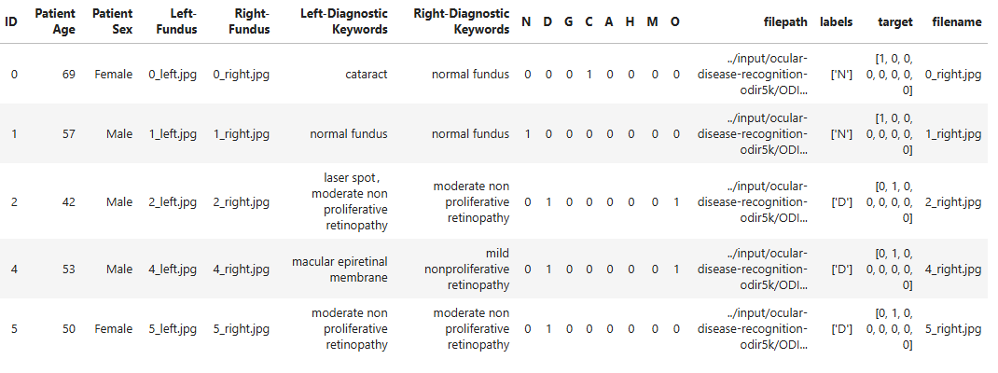

Slide 6
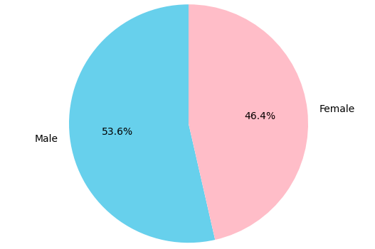
Data Understanding with Visualizations
Distribution of patient gender

Slide 7
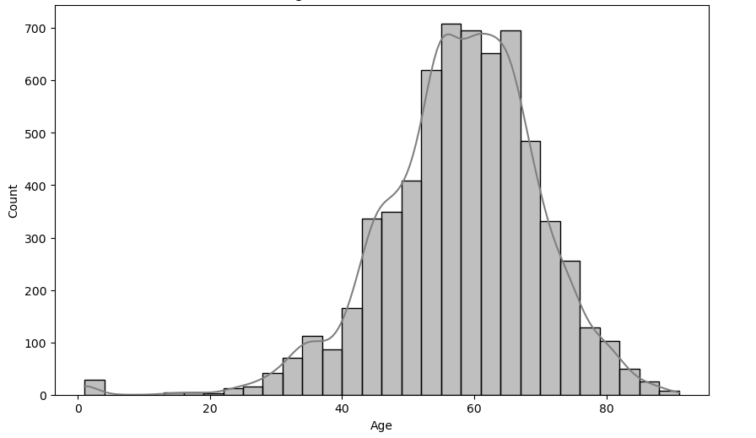
Age Distribution of Patients

Slide 8
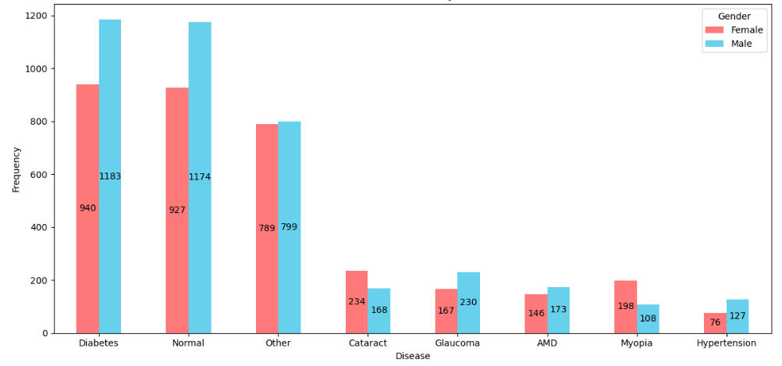
Gender-Based Disease Prevalence Distribution

Slide 9
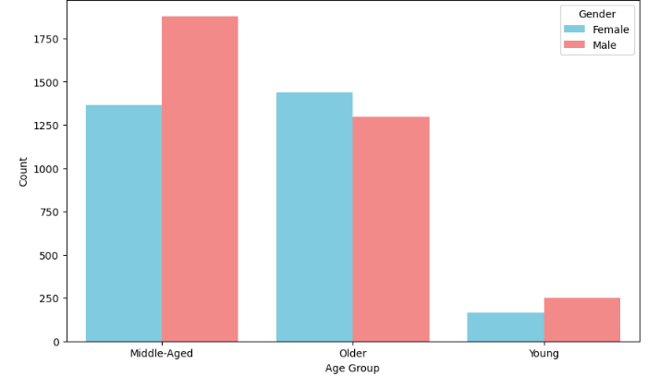
Gender Distribution within Age Groups

Slide 10
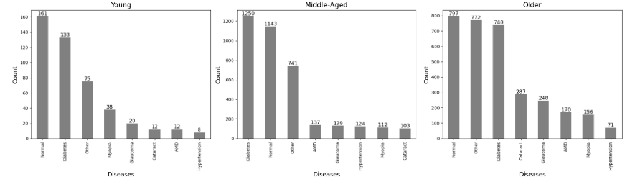
Disease Prevalence by Age Group

Slide 11
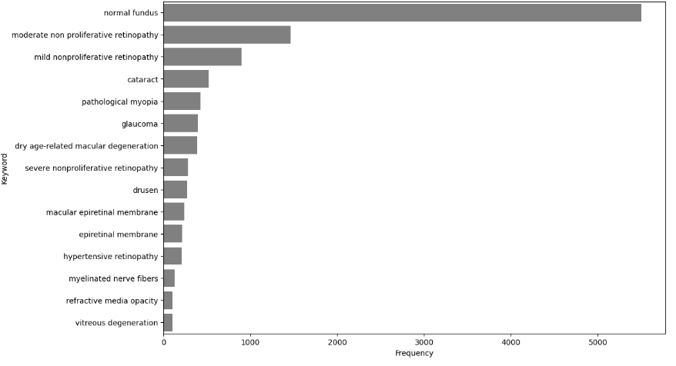
Top Diagnostic Keywords

Slide 12
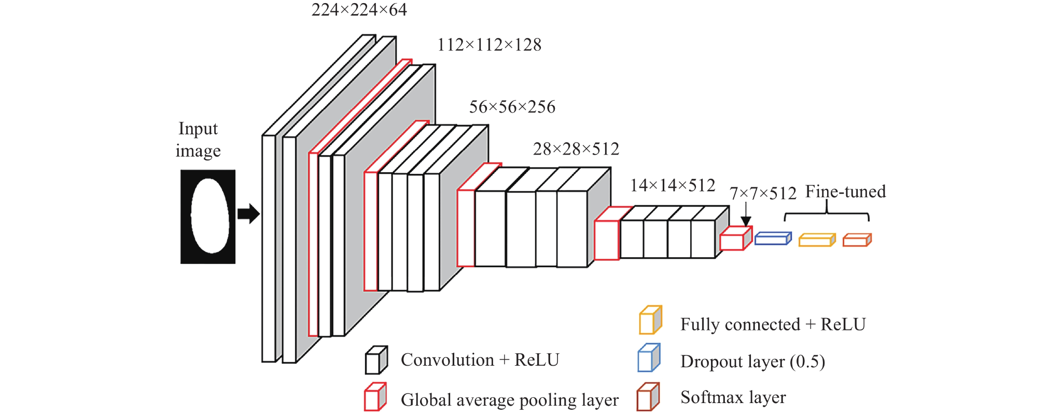
Model
VGG19 : It is a convolutional neural network trained on a subset of the ImageNet dataset, a collection of over 14 million images belonging to 22,000 categories.It has 138 million parameters with a total of 19 layers including weights.

Slide 13
Tools and Libraries
Python - Core programming language for all code development.
TensorFlow/Keras - For implementing the deep learning model (VGG-19, CNN layers, custom fully connected layers).
Pandas - For data handling, such as loading, cleaning, and structuring CSV data.
NumPy - For numerical operations and matrix manipulations on the image data.
Matplotlib/Seaborn - For visualizing data, such as plotting accuracy and loss curves and creating EDA plots.
OpenCV or PIL - For image processing tasks, like resizing, normalization, and augmentation of fundus images.
Scikit-learn - For model evaluation metrics like accuracy, F1 score, and confusion matrix, as well as for data splitting and stratification.

Slide 14
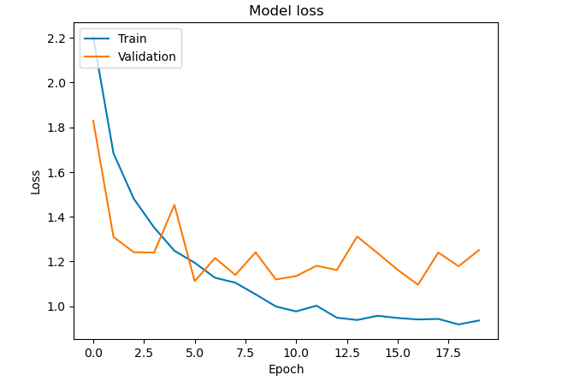
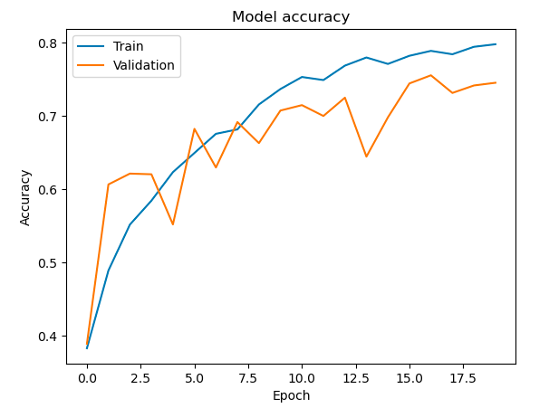
Model result

Slide 15
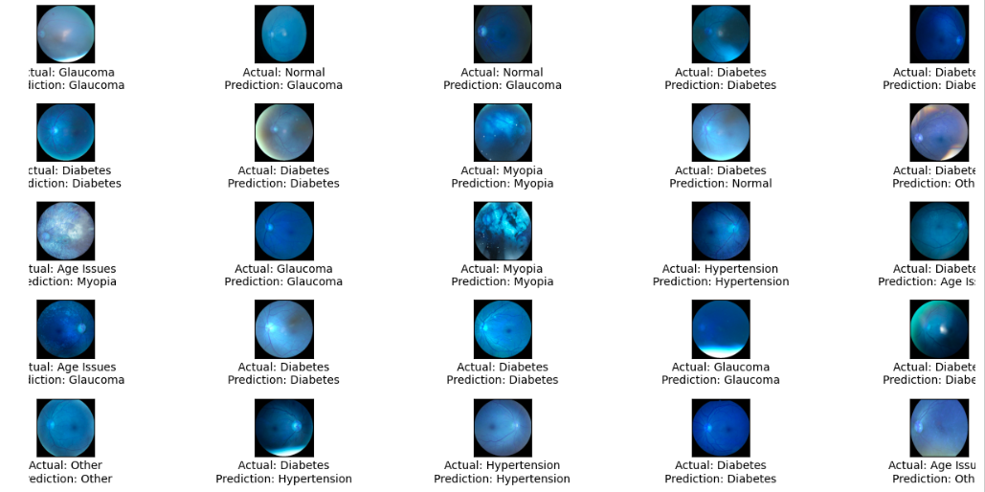
Result

Slide 16
Data Challenges
1.Overfitting
Solution: Regularization,Early Stopping,Cross-validation
2. Data Imbalance
Solution: Class Weights,Data Augmentation

Slide 17
Evaluation and Performance Metrics
Accuracy: The percentage of correctly classified samples.
Loss: The categorical cross-entropy loss, which measures the model's prediction error.
Confusion Matrix: To see the misclassifications for each disease, helping to identify which diseases are commonly confused by the model.
AUC-ROC: To assess the model’s ability to distinguish between classes, especially important for imbalanced datasets.
G-score: It measures the balance between precision and recall, focusing on how well the predicted classes match the true classes.

Slide 18
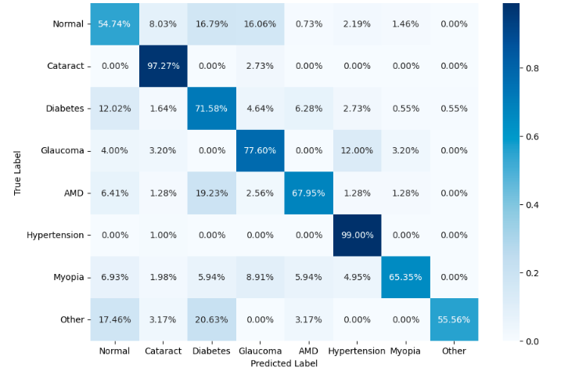
Confusion Matrix

Slide 19
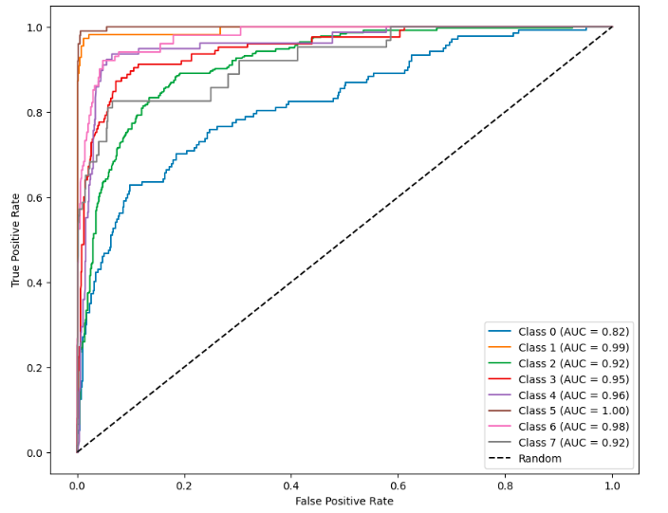
AUC-ROC

Slide 20
Next Steps and Improvements
Model Improvement
Data Augmentation and Expansion
Evaluation and Validation
Deployment and Integration
Collaboration and Research
Image Processing

Slide 21

for your attention

